Slide 1
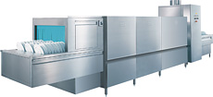
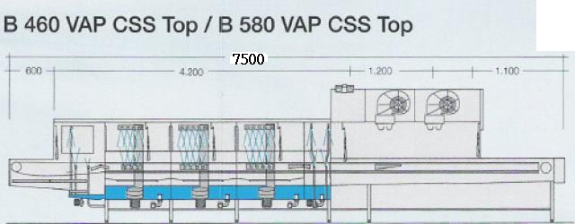
MEIKO Belt Conveyor dish washing machine
來至MEIKO，是一家專門製造各類清洗機的德國專業廠家，從小型洗碗機至醫院大量容量使用的隧道式全自動洗碗機，一應俱全。
MEIKO B-Tronic 全自動洗碗機
Meiko Model : B460 VAP- CSS-TOP
Machine overall length : 7500mm
direction L-R ( double blower drying device)
TEL:26587810 FAX:26587801 E-mail:leador.washer@msa.hinet.net
http//www.leader21tw.net
力多超音波有限公司

Slide 2
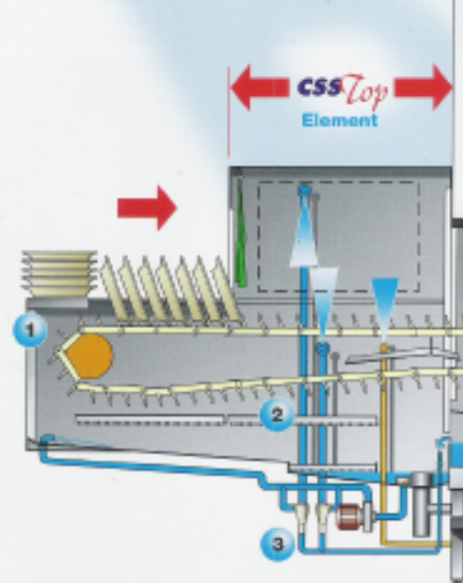
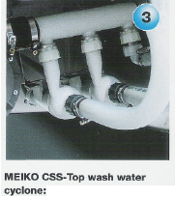

MEIKO B-Tronic 全自動洗碗機
MEIKO® Model: B460 VAP- CSS-TOP
Css-Top
Meiko Model: B460 VAP- CSS-TOP
specifications:
1. loading section with css-top saving device
a. guarantee saving detergent up to 50 %
b. according to rinse water 360 l/hr /detergent dosing unit 4 g/l /we can save 0.72 kg/hr x 7 x 365 =1840 kg /year(per day 7 hours /one year 365 days )
c. detergent price : 2500 NT$/25kg
d. So one year can save 184,000.- NT$/Year(10 year can sve 1,840,000.- you can save almost one machine)
十年節省壹百八什肆萬元 清潔濟的費用
1

Slide 3
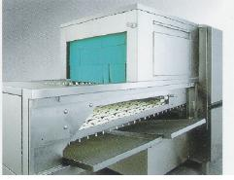
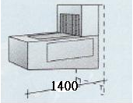
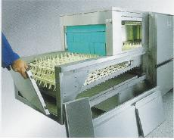
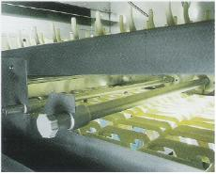
MEIKO B-Tronic全自動洗碗機
MEIKO® Model: B460 VAP- CSS-TOP
MEIKO® B-TRONIC
1. loading section with css-top saving device
a. guarantee saving detergent up to 50 %
b. 1400 mm long
2

Slide 4
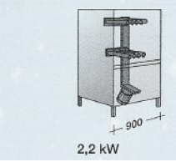
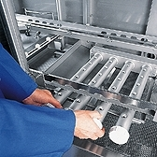
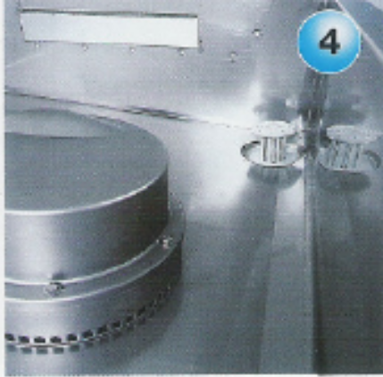
MEIKO B-Tronic全自動洗碗機
MEIKO® Model: B460 VAP- CSS-TOP
MEIKO® B-TRONIC
2. pre washing ( pre wash tank)
a. pump power 2.2 kw
b pump flow rate 1380 l/min
c. Tank Heatig 3600 KJ
d. 900 mm long
2

Slide 5
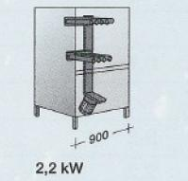
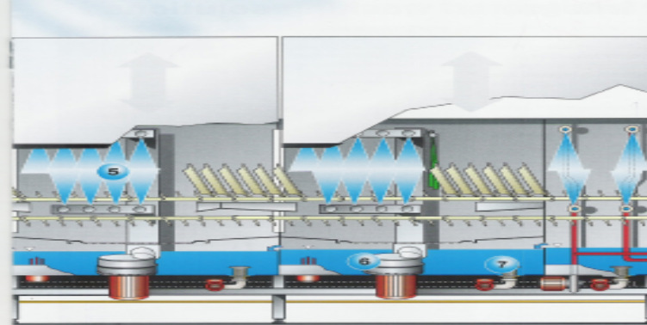
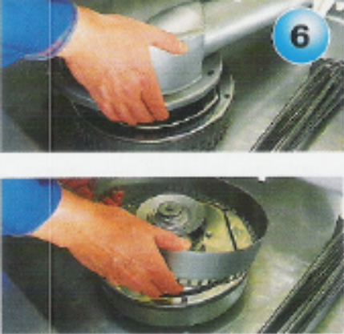
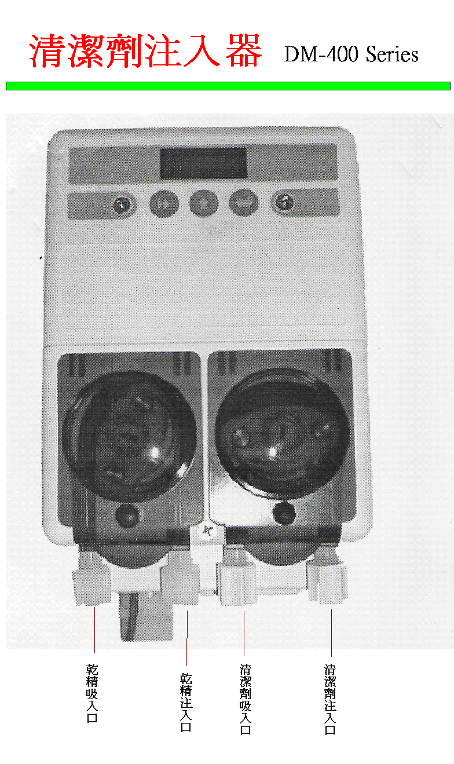
MEIKO B-Tronic 全自動洗碗機
MEIKO® Model: B460 VAP- CSS-TOP
MEIKO® B-TRONIC
3. washing with detergent (1,st wash tank)
a. pump power 2.2 kw
b pump flow rate 1380 l/min
c. Tank Heatig 3600 KJ
d. 900 mm long
.
Dosing unit
2

Slide 6
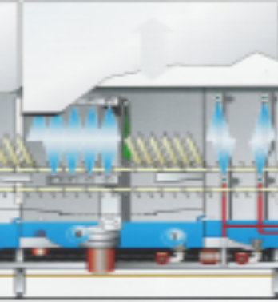
MEIKO B-Tronic 全自動洗碗機
MEIKO® Model: B460 VAP- CSS-TOP
MEIKO® B-TRONIC
4.recirculation rinse( 2,nd wash tank)
a. pump power 2.2 kw
b pump flow rate 1380 l/min
C. Tank Heatig 3600 KJ
d. 900 mm long
.
2

Slide 7
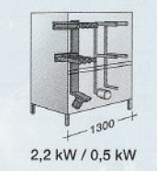

MEIKO B-Tronic 全自動洗碗機
MEIKO® Model: B460 VAP- CSS-TOP
MEIKO® B-TRONIC
5. double final rinse
a. pump power 0.5 kw
b. Tank Heatig 3600 KJ
c. 400mm long
5-1. double final rinse energy saving
d. energy saving 18 kg/hr(according to 360 l/hr final rinse steam consumption filling water temp. 20-25℃)
e. booster energy saving 29 kg/hr
f. so double final rinse saving steam 47 kg/hr=71553 NT$//year
.
2

Slide 8
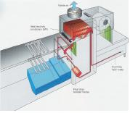
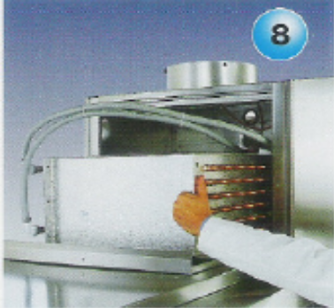
MEIKO B-Tronic 全自動洗碗機
MEIKO® Model: B460 VAP- CSS-TOP
MEIKO® B-TRONIC energy saving system
6. heat recovery system with condenser and heat exchange
a. waste air fan+drive 0.3kw
b. waste air fan controlled by frequency converter
c. water cost 8.7NT$/1000 m3 、 electric cost 1.8366 NT$/kw/hr、steam cost 595.86 NT$/1000kg/hr
6-1 Other energy saving
a. rinse acid energy saving368kg/year (according dosing unit 0.4 g/l /7hrper day/365 days per year)=44160 NT $/year
b. water cost 40 m³
2

Slide 9
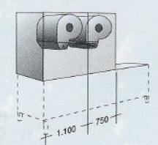
MEIKO B-Tronic 全自動洗碗機
MEIKO® Model: B460 VAP- CSS-TOP
MEIKO® B-TRONIC drying section
7. drying section
a. Air circulating 3460 m3/h
b. fan capacity 1.5 kw
c. suction quantity 1400 m3/h
2

Slide 10
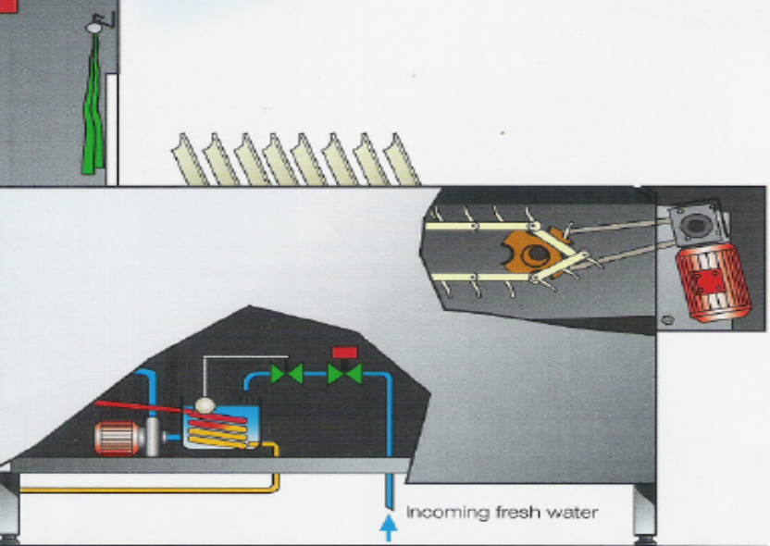
MEIKO B-Tronic 全自動洗碗機
MEIKO® Model: B460 VAP- CSS-TOP
MEIKO® B-TRONIC belt drive system
8. conveyor speed 3 speed :
a. speed 1: 1.8 m/min / speed 2: 2.55 m / min/speed 3 : 2.95 m/min
2

Slide 11
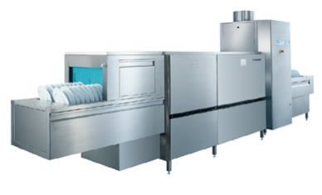
MEIKO 輸送帶式全自動洗碗機
MEIKO® B-TRONIC
9. Wash capacity
a. tray 500 x400 mm---- pcs /hr
b. plate 300 d mm---- pcs /hr
c. bowel 105 d mm---- pcs /hr
e. spoon forks chopsticks----- pcs /hr
10. electrical installation : 3p/380v/60hz with automatic circuit breaker
11. steam pressure 0.5-3 bar /2”pipe
steam consumption : 86 kg/hr
heating register 36,000 kj
12. filling:
water 3/4” pipe
di water filling for final rinse 3/4” pipe
css plus –system 3/4” pipe
13. 2” drain: central drain pipe work for 4 drains
14. total power : 12.2 kw
5

Slide 12
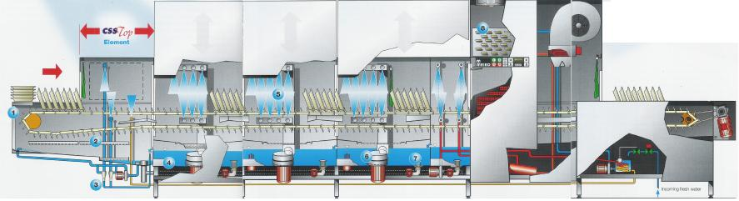
MEIKO 輸送帶式全自動洗碗機
MEIKO® B-TRONIC
B-Tronic
清洗符合行政院衛生署餐飲洗滌管 理規定！！
需有三槽式清洗：輸送帶式全自動洗碗機三段式清洗
需有高溫清洗、溫度達80℃以上：具有蒸氣洗，且溫度達90℃以上
目視檢查不能有食品殘留物：高壓噴洗
本公司 所提供之洗碗機為高性能、高效率，又符合行政院衛生署餐飲洗滌管理之検測相關規定，所以敬請安心使用。
5

Slide 13
MEIKO 輸送帶式全自動洗碗機
MEIKO B-Tronic continuous conveyor belt dishwashing machines
Dedicated focus, continuous research and development, outstanding quality, and user friendly appliances - this is the basis for the present generation of exciting and innovative MEIKO B-Tronic continuous conveyor belt dishwashing machines, and the profile of a reliable and competent partner in modern dishwashing technology.
The optimized conveyor dishwasher series has been outstanding in the goals achieved in the areas of economy, ecology and hygiene. New ideas, new technology and new details offer exceptional benefits to the customers in unmistakable, reassuring MEIKO quality.
Tried and tested features have been retained. For example:
V-shaped wash tanks for effective cleaning
Self-draining stainless steel re-circulating wash pumps
Manifolded block wash systems for powerful cleaning
Cost-saving low temperature drying
Maintenance-friendly heat recovery condensing system
Powerful and effective pump final rinsing system
Improved washing systems and attention to detail have resulted in increased cleaning quality, operator safety, and overall economy. For example:
State of the art CLEAN CONTROL TECHNOLOGY -economy, ecology and total hygiene management
Cost-saving and environmentally friendly CSS chemical saving system
Wash pump filter sieve, removable strainer flaps, tank filter trays, indented wash jets, etc., have improved operational performance.
On the following pages we have illustrated all the main features offered with the improved B-Tronic series of conveyor belt machines.
6

Slide 14
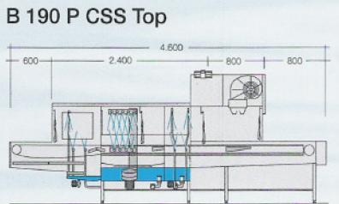

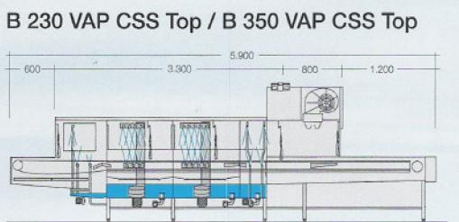
MEIKO 輸送帶式全自動洗碗機
MEIKO B-Tronic continuous conveyor belt dishwashing machines
6

Slide 15
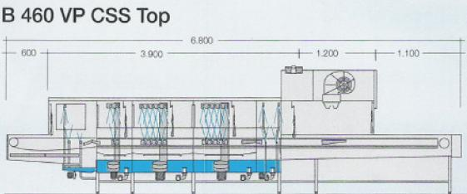
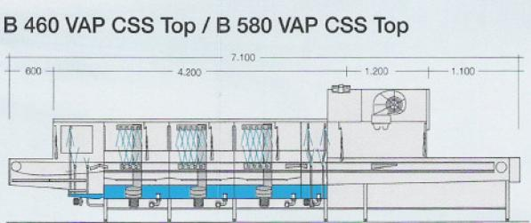
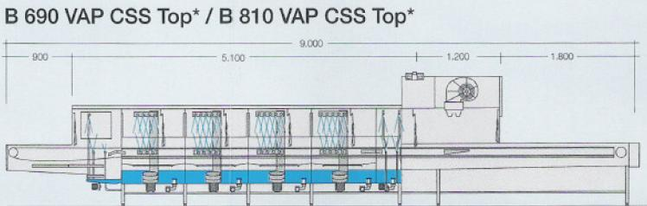
MEIKO 輸送帶式全自動洗碗機
MEIKO B-Tronic continuous conveyor belt dishwashing machines
6

Slide 16


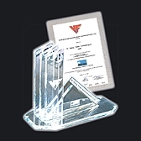
MEIKO B-Tronic
continuous conveyor belt dishwashing machines
The CSS chemical saving system
detergent saving up to 50%
now as a standard for all Meiko B-tronic conveyor belt dishwashing machines
detergent saving up to 80%
no theory, but with MEIKO
technically materialized and approved
approved in practice
Awarded with the 2000 Dr Georg Triebe Prize for innovation.
7

Slide 17
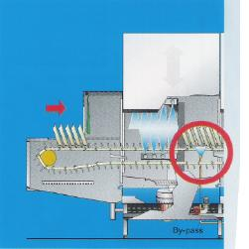
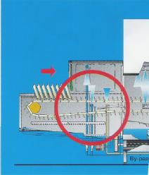
MEIKO B-Tronic
continuous conveyor belt dishwashing machines
The CSS chemical saving system
detergent saving up to 50%
now as a standard for all Meiko B-tronic conveyor belt dishwashing machines
detergent saving up to 80%
no theory, but with MEIKO
technically materialized and approved
approved in practice
7

Slide 18
MEIKO 輸送帶式全自動洗碗機
MEIKO® B-TRONIC
Belt conveyor and Basket transport machine with Low-Energy-Management
Save money and energy
MEIKO is the leading brand for all forms of belt conveyor and automatic basket transport machines. Quality, technology, very many advantages for the customer and exceptional economy have created the B- and K-Tronic’s success. Now we have made its already outstanding low energy consumption even more efficient as you can convince yourself on the next page.
The top five innovations for optimised energy management
10

Slide 19
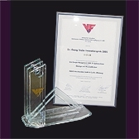
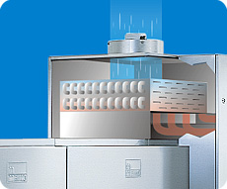
MEIKO® B-TRONIC
MEIKO 輸送帶式全自動洗碗機
with Low-Energy-Management
We have optimised the energy management system of our very well known B- and K-Tronic machines with the five pioneering innovations, which create significant savings in energy consumption and ensure even greater hygiene and quality of the working environment
Awarded with the 2005 Dr Georg Triebe Prize for innovation
Save money and energy
10

Slide 20
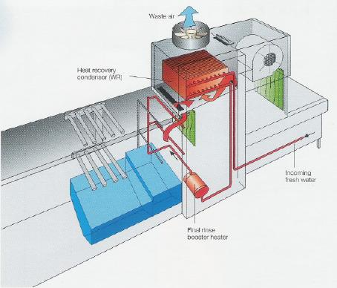
MEIKO® B-TRONIC
MEIKO 輸送帶式全自動洗碗機
with Energy Saving System
10

Slide 21
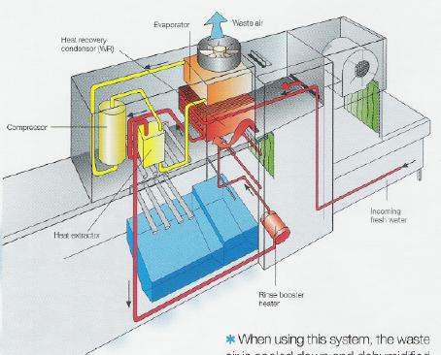
MEIKO® B-TRONIC
MEIKO 輸送帶式全自動洗碗機
with Energy Saving System 2
10

Slide 22
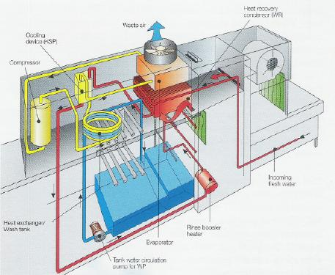
MEIKO® B-TRONIC
MEIKO 輸送帶式全自動洗碗機
with Energy Saving System 3
10

Slide 23
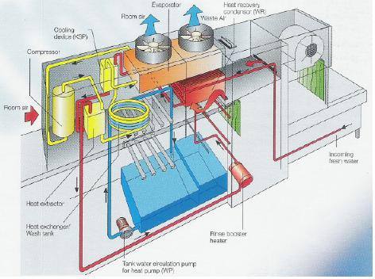
MEIKO® B-TRONIC
MEIKO 輸送帶式全自動洗碗機
with Energy Saving System 4
10

Slide 24
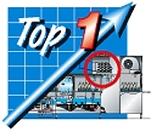
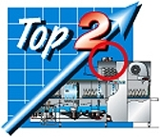
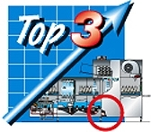
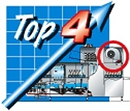

Belt conveyor and Basket transport machine with Low-Energy-Management
MEIKO® B-TRONIC
Detailed optimisation has increased the efficiency of exhaust air heat recovery up to 20%.
Significant reductions in the heat and humidity in the exhaust air have produced an exceptional reduction on the demands placed on the “air treatment plant” (RLT).
Optimally pre-heating the rinsing water has reduced the heating energy consumption in the flow heater up to 20%.
Significant improvements to the air supply in the drying cycle have reduced blower demand and heating energy consumption by 30% up to 50%.
A new process technology with process-oriented energy distribution ensures optimised adaptation to changing operating conditions. (Washing start-up, main washing operations, stand-by etc).
The exhaust air is automatically controlled in line with throughput.
Permanently stable tank temperatures help to safeguard high-quality cleaning
10

Slide 25
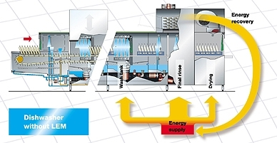
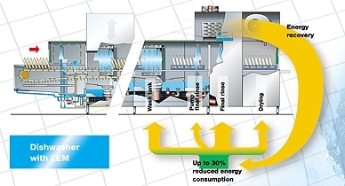
Belt conveyor and Basket transport machine with Low-Energy-Management
MEIKO® B-TRONIC
without LEM
with LEM
The exhaust air is automatically controlled in line with throughput.
Permanently stable tank temperatures help to safeguard high-quality cleaning
13

Slide 26
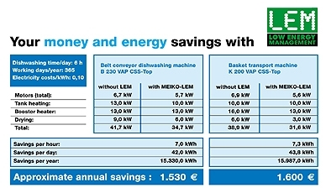
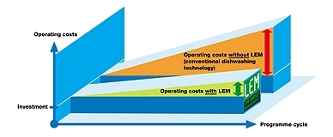
Belt conveyor and Basket transport machine with Low-Energy-Management
MEIKO® B-TRONIC
with LEM
LEM Low Energy Management
Reduced energy consumption and overall energy management
Reduction in the connected load by up to 30% through machine optimization
Process oriented energy redistribution adapted to the actual operating condition
Wash and save with MEIKO in your kitchen - convince yourself and look at our comparison charts
14

